Slide 1









Smart Robot for child development and protection, using storytelling and facial recognition based on an AI approach
Abdelhady Gamal
Ali Khater
Karim Elbarbary
Mohamed Abdelnaby
Mohamed Yehia
Omar Zahir
Yasmin Yaseen
Ziad Mohamed

Slide 2
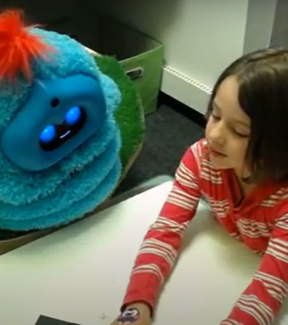
Previous research: Artificial listener with social intelligence
storytellers employ a certain but subtle social cueing strategy when they believe a listener is paying attention to their story.

Slide 3
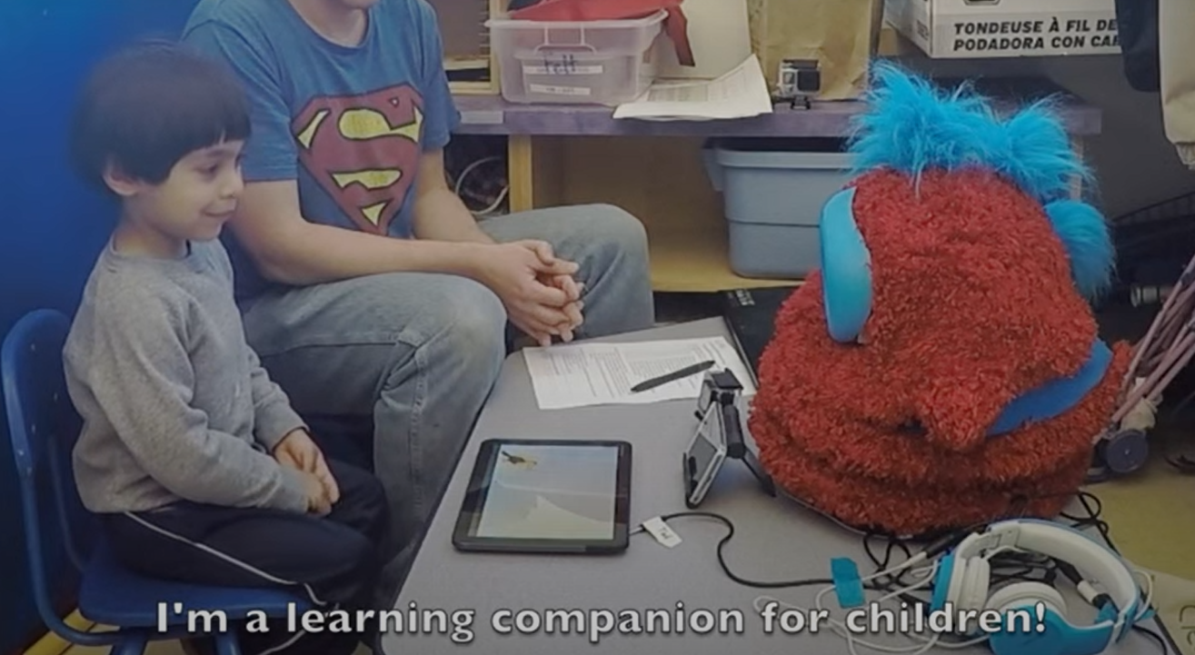
Previous research: “Tega” a social robot
Tega is a new robot platform designed to support long-term, in-home interactions with children, with applications in early-literacy education from vocabulary to storytelling.

Slide 4
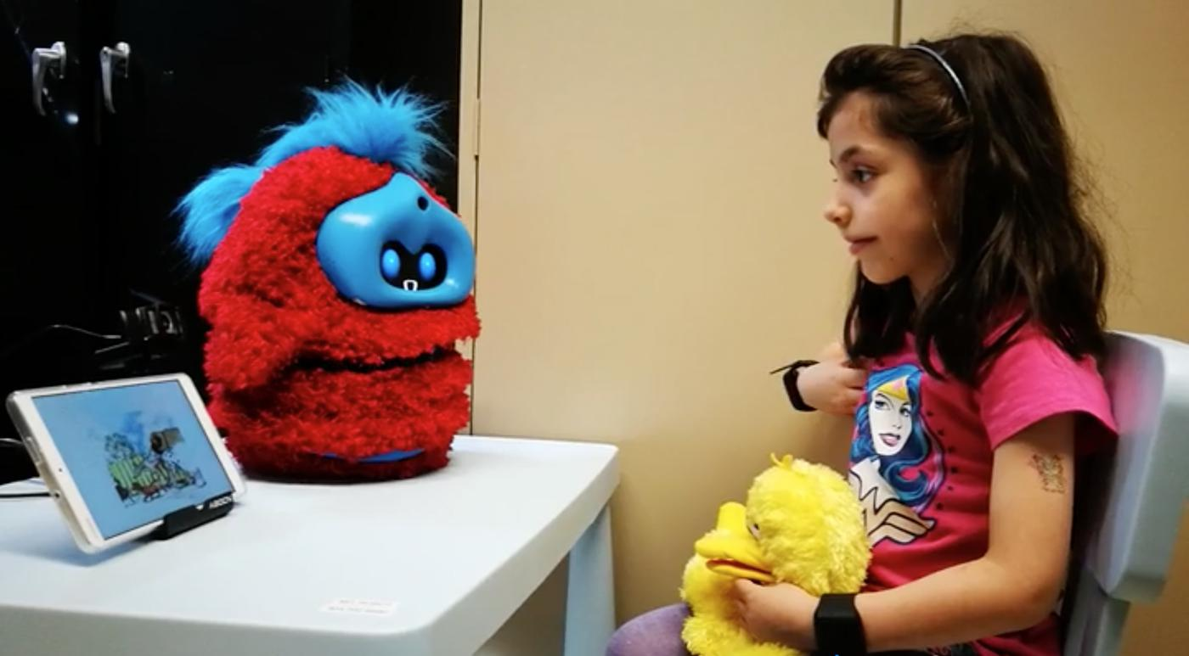
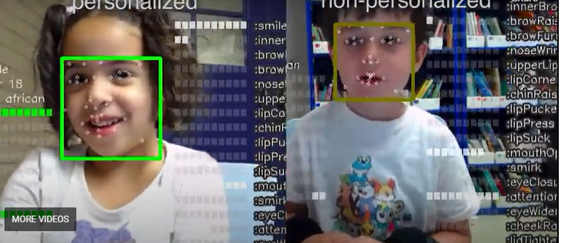
Previous Research: Personalized Robot Storytelling Companion
learn actions that improve children's storytelling and keep them engaged. We are also interested in how a social robot can personalize its interaction with each child over multiple encounters, because every child learns and engages differently.

Slide 5

Surveys and research
Product design should be built upon research and facts, not assumptions.

Slide 6
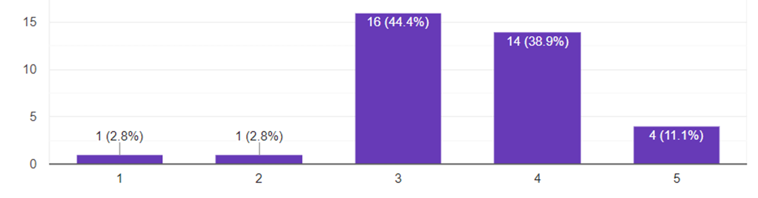
Research Results: Parents struggles
To what extent do Parents think that you are aware of your child's feelings and are able to deal with them appropriately

Slide 7
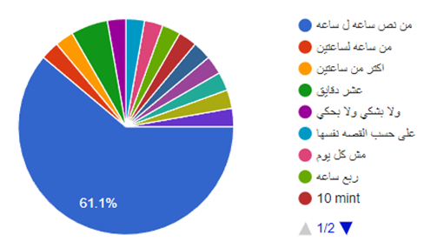
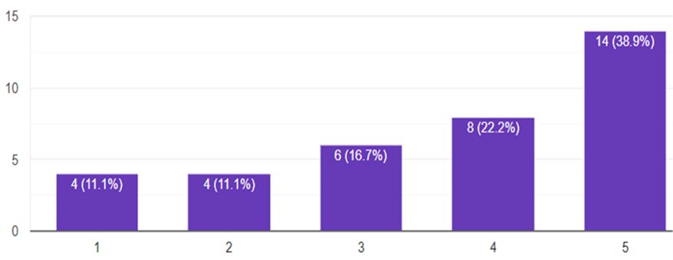
Research Results: Story
Importance of stories for our children.
Listening time daily of stories

Slide 8
Research results: Impact of stories on children
More than 60% of the answers Storytelling activity has a high impact on children's feelings, Interactions, and imagination.
Feeling intimate, content, comfortable and sleeping better, tender, calm, Empathy and help others.
Ability to control anger.
Learn to listen.
Be more emotional and less nervous.
Learn the skill of dialogue and talking with others.
Connecting events to reality.
Imagine the character and form an idea about it and try to simulate it in reality.
Changing some of his wrong behaviors and developing positive behavior through the story.
Pay attention to the right habits.
Imitating the character and trying to do the positive and avoid the mistake of the hero in the story.
Think about the significance of the story in similar situations in life.
He starts putting possibilities for the world and how people deal with each other.

Slide 9
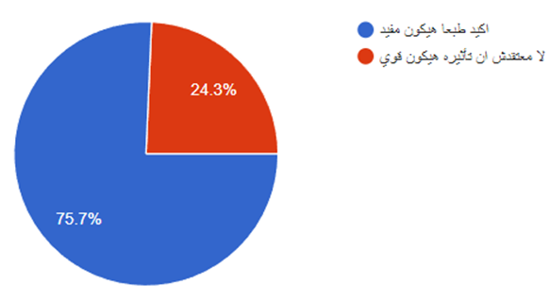
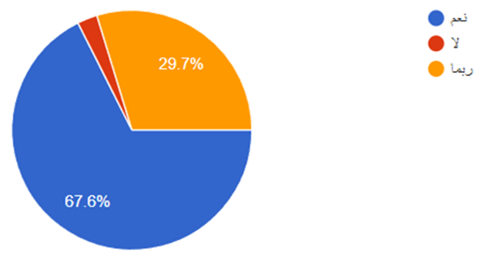
Research results: Parents adoption to our idea
How much they think it would be useful
How much they think their children will get
along with the robot

Slide 10

Mobile Application Development Process

Slide 11
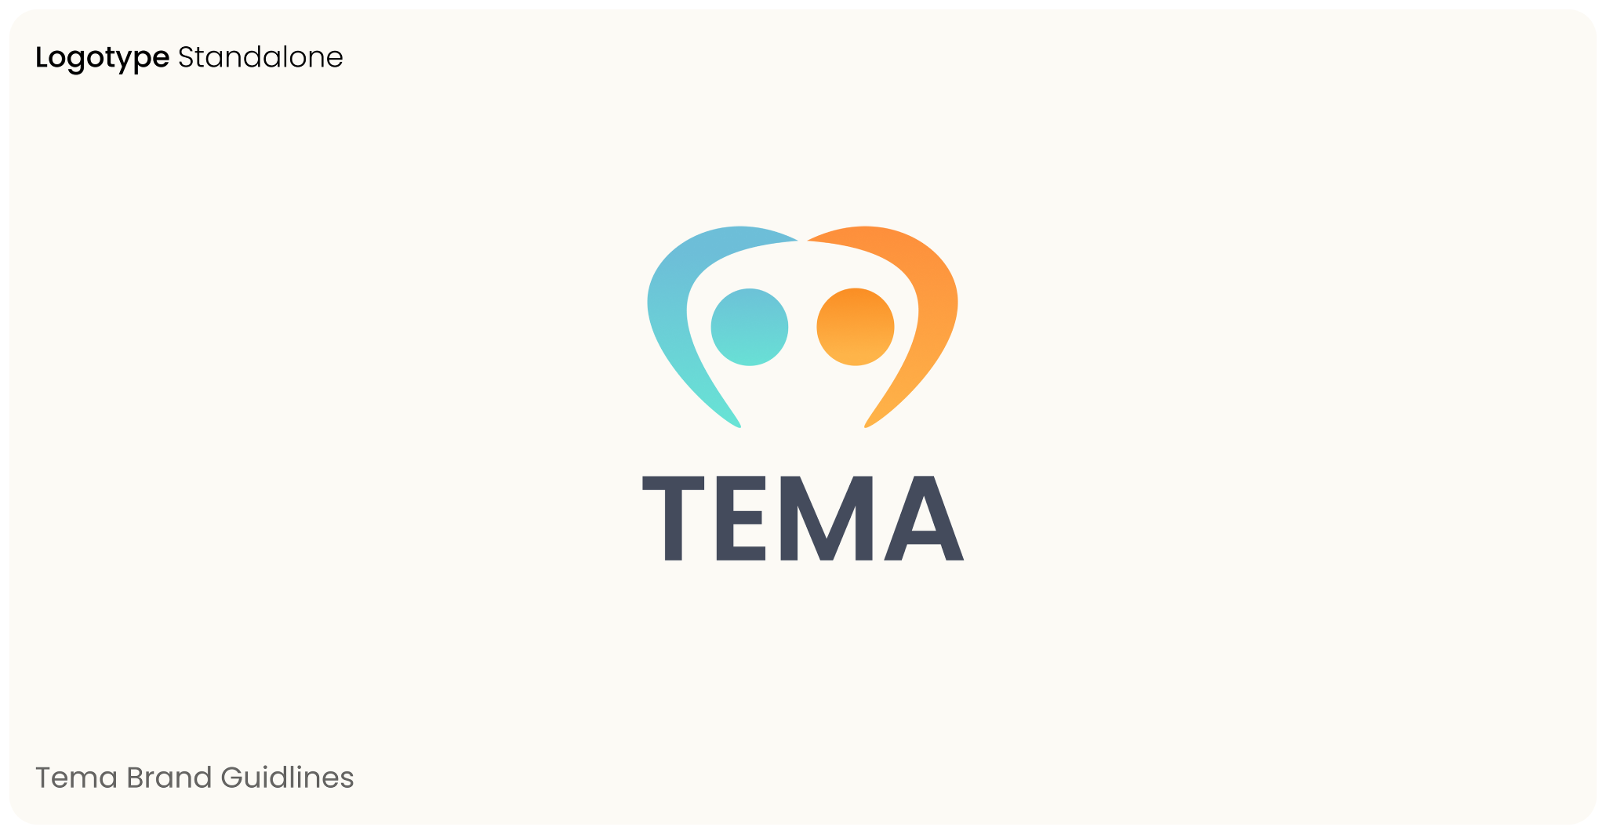

Slide 12
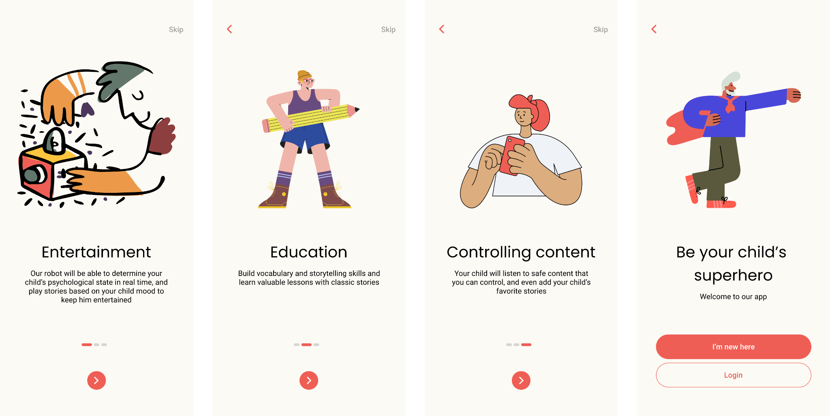

Slide 13
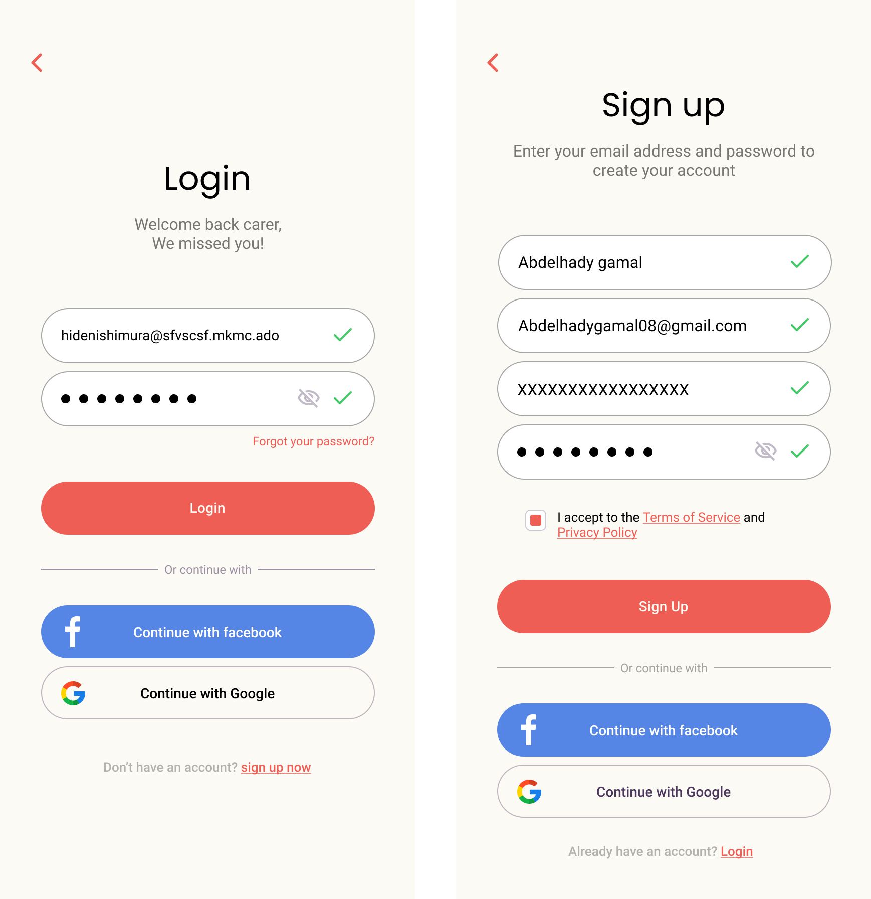

Slide 14
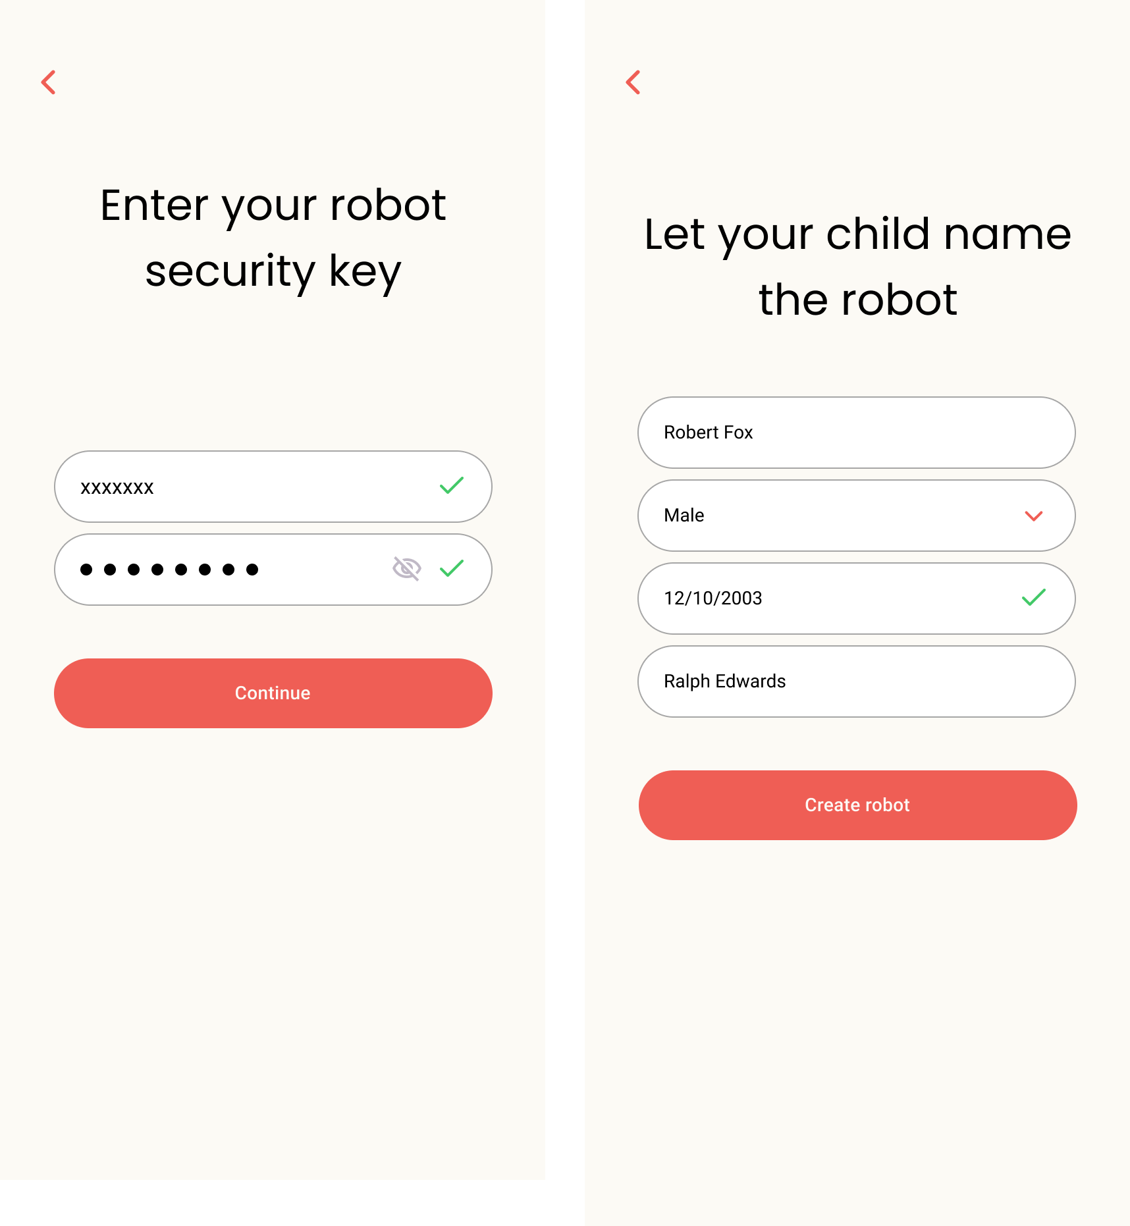

Slide 15

Sign-in limitation
Our business model imposes that a user can't use the mobile application unless they own a robot, so the registration process requires user to enter their own information, child information and robot information.
This is handled by a transaction, so it is guaranteed that each and every parent is linked to a robot, creating a parent account without being linked to a child account or a vacant robot document is not allowed.

Slide 16
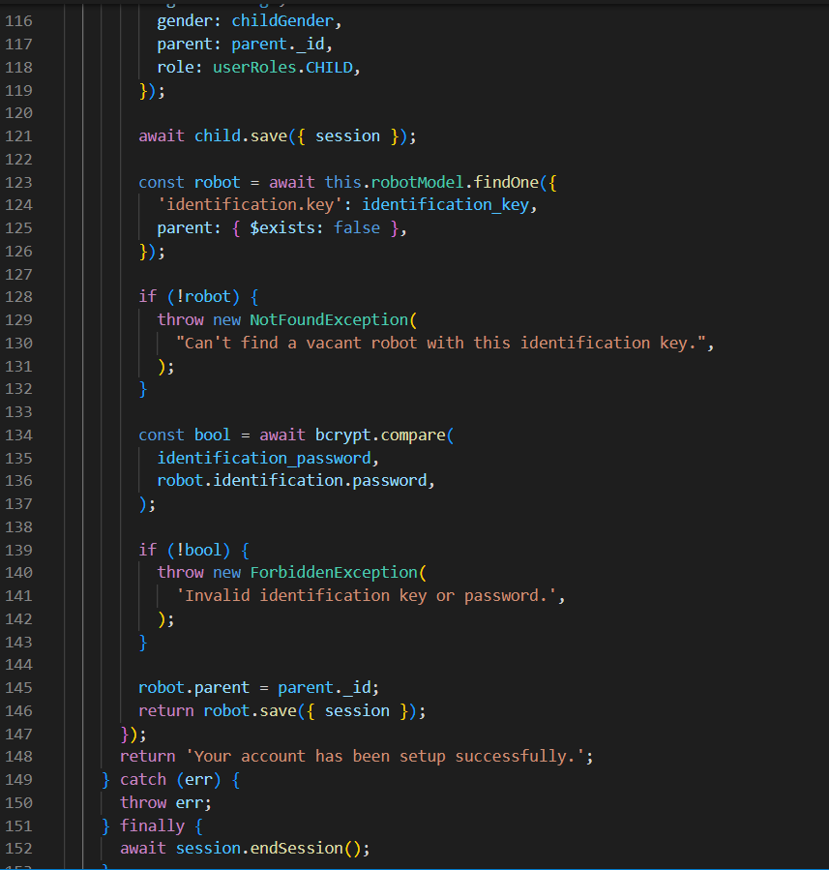
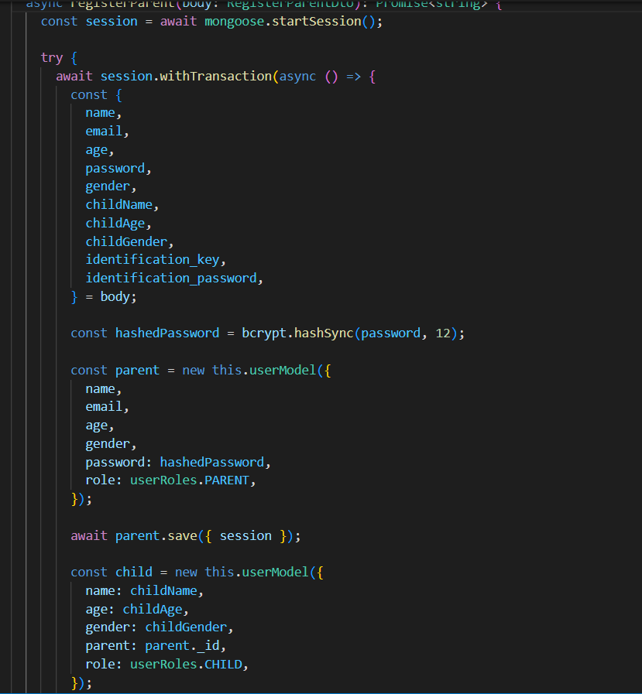

Slide 17
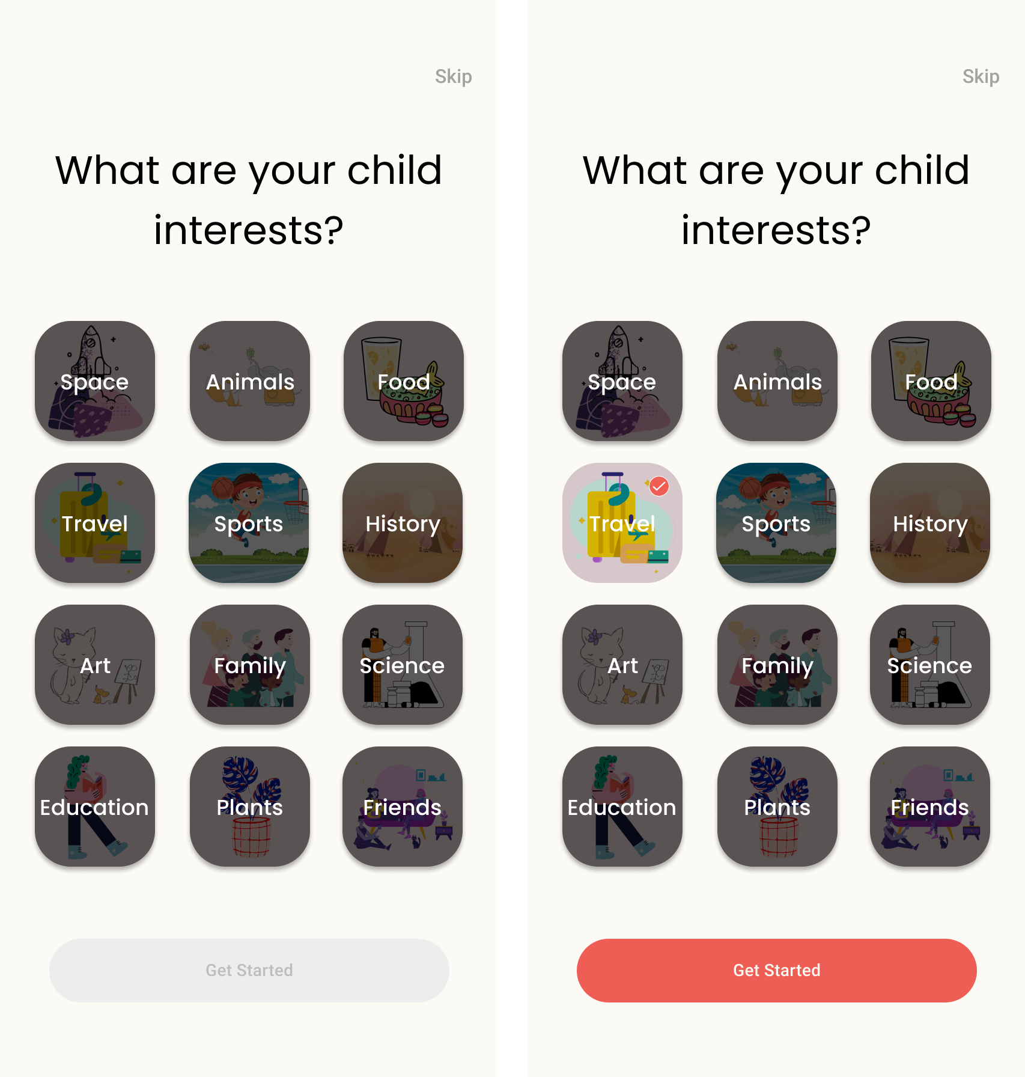

Slide 18
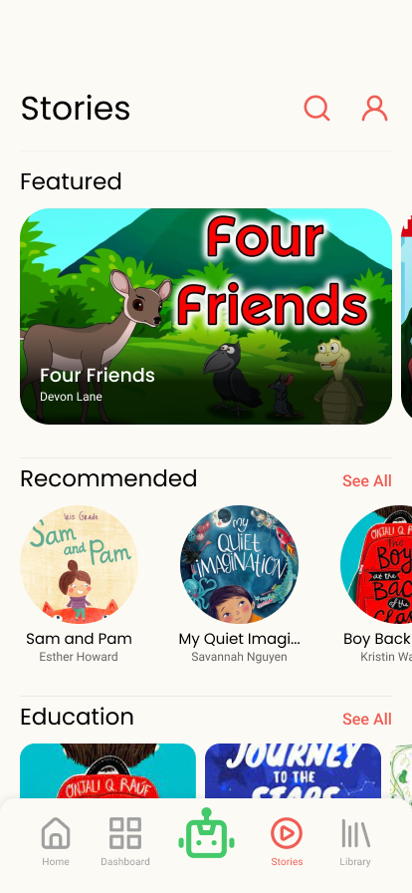
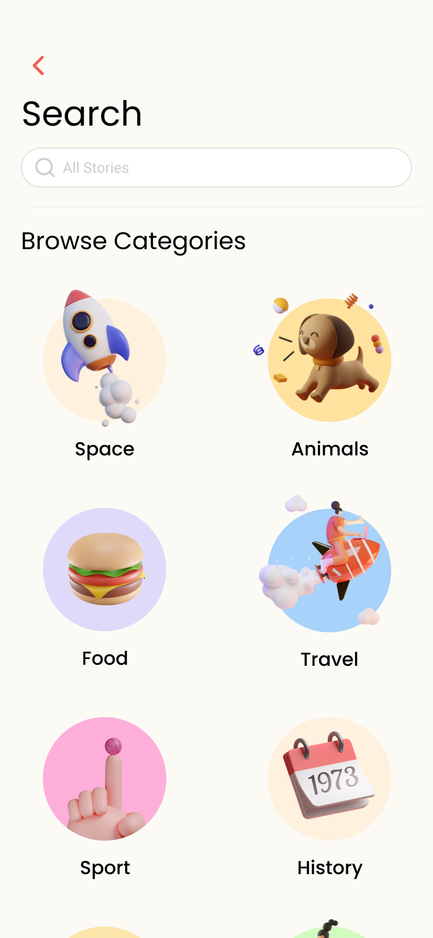
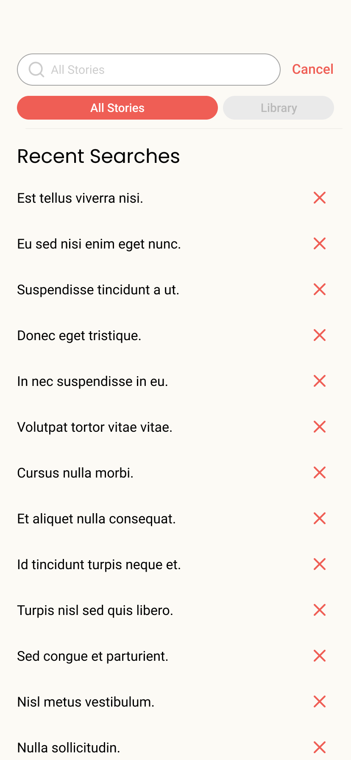
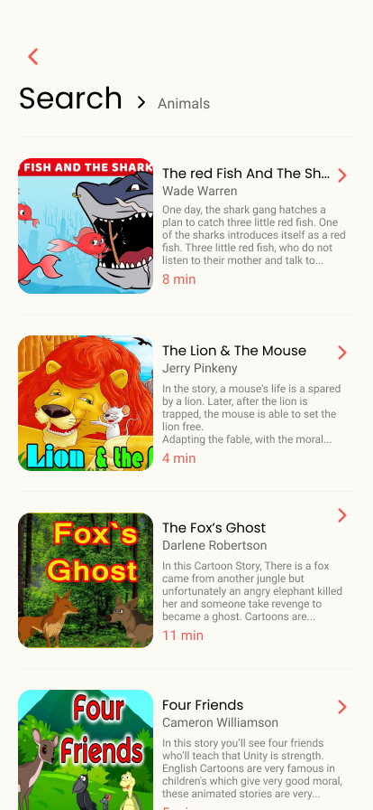

Slide 19
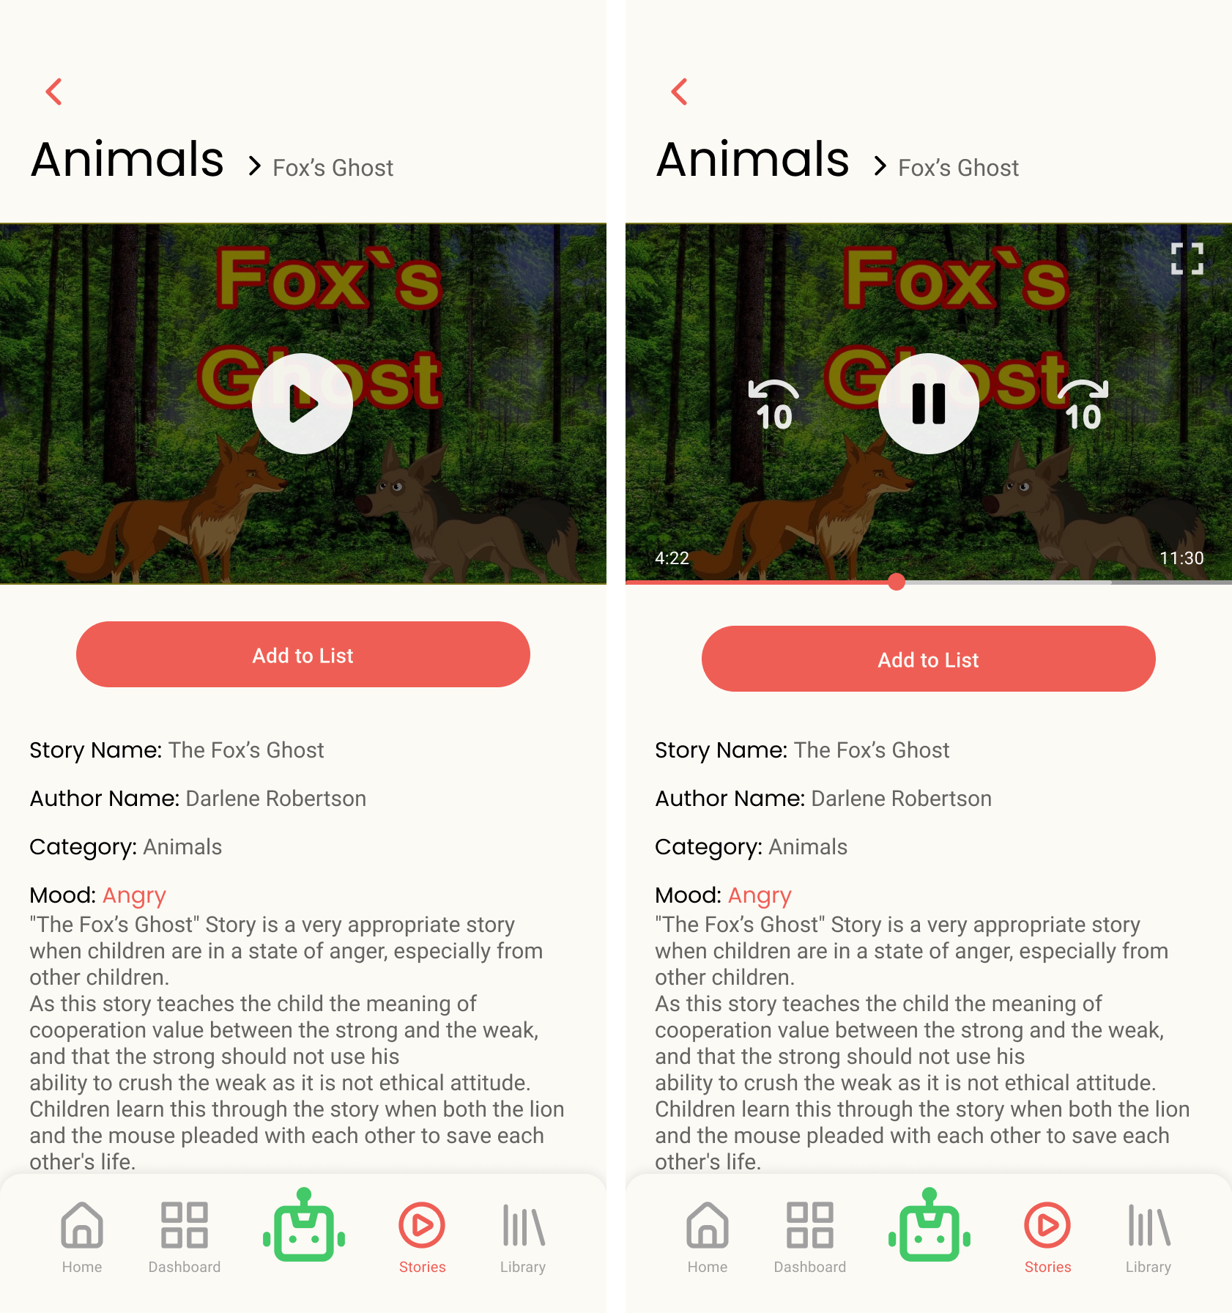

Slide 20
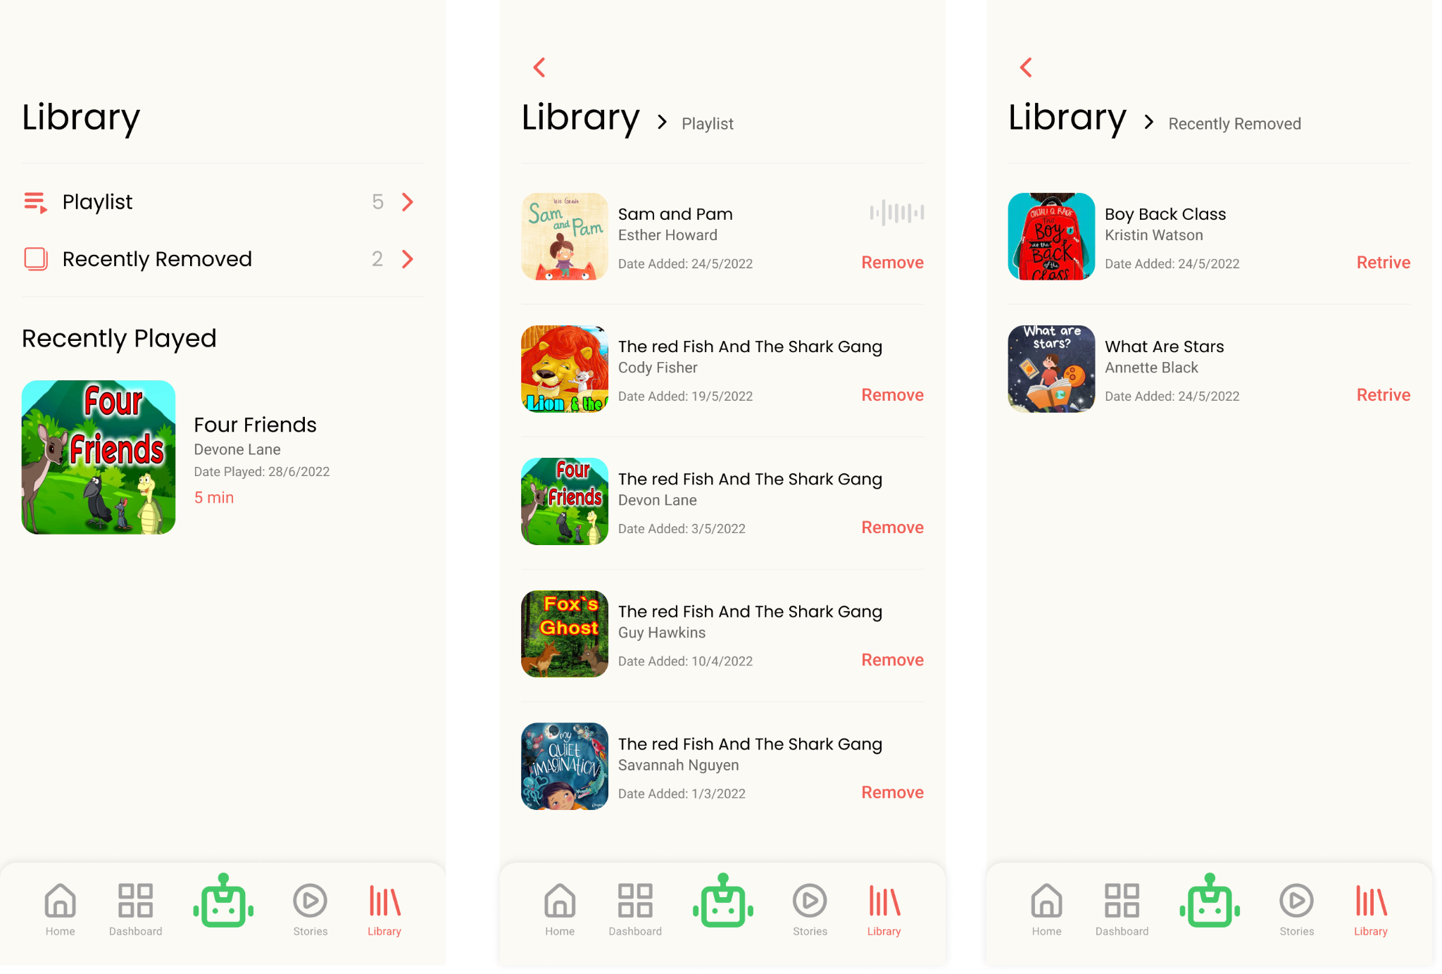

Slide 21
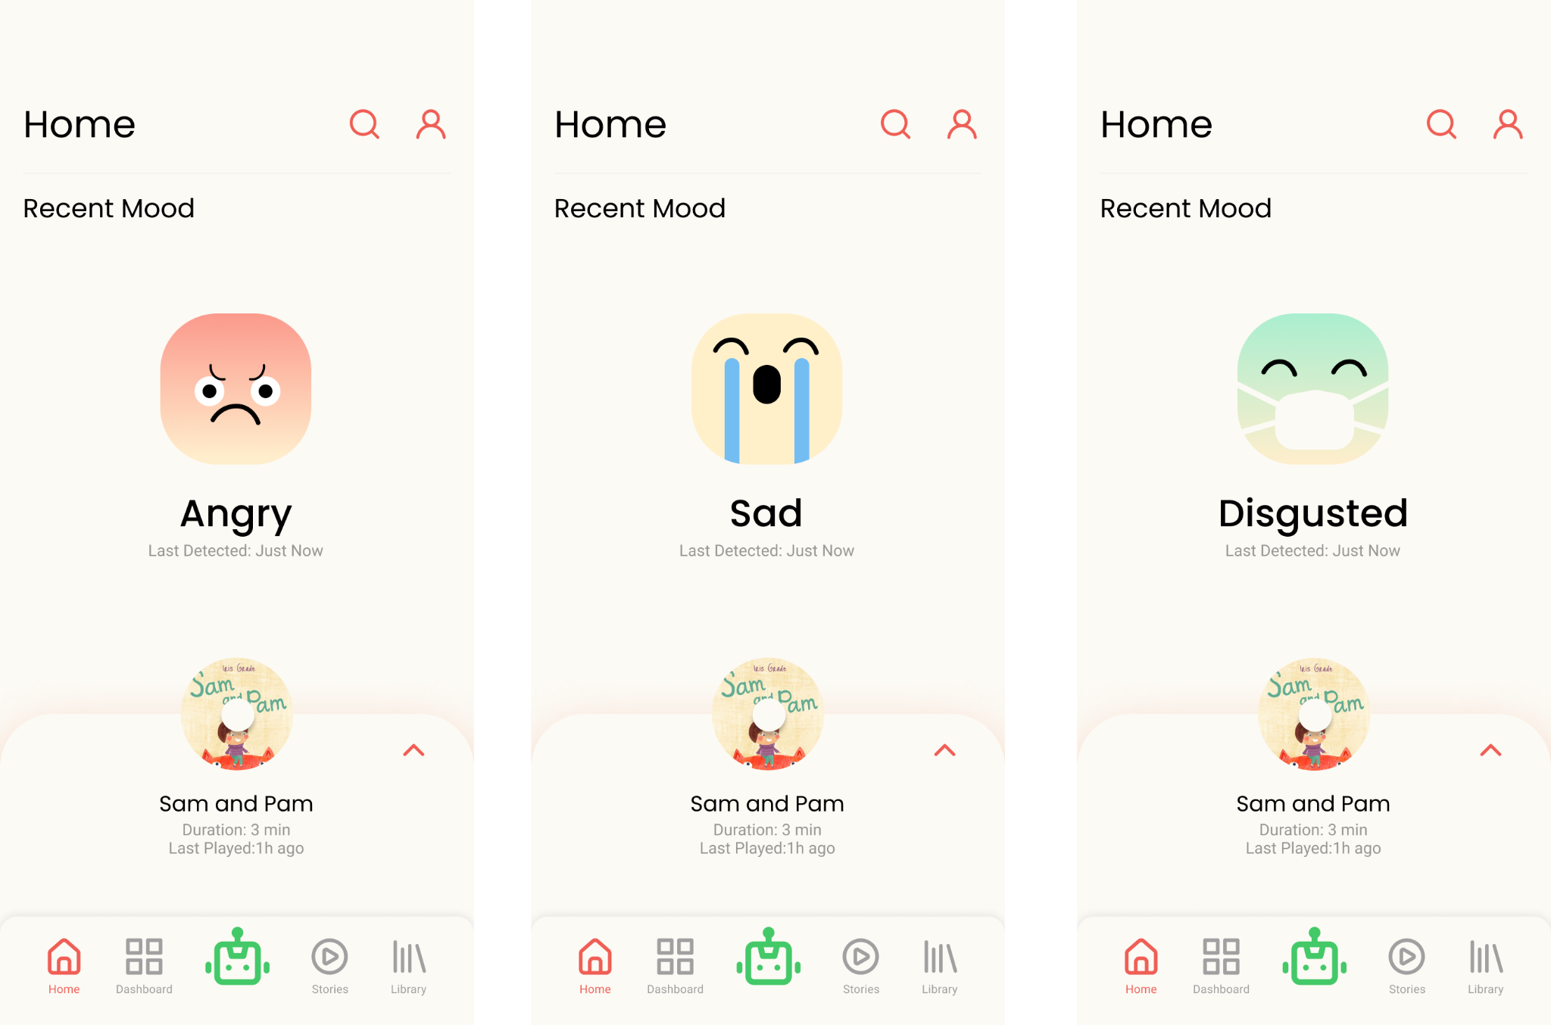

Slide 22
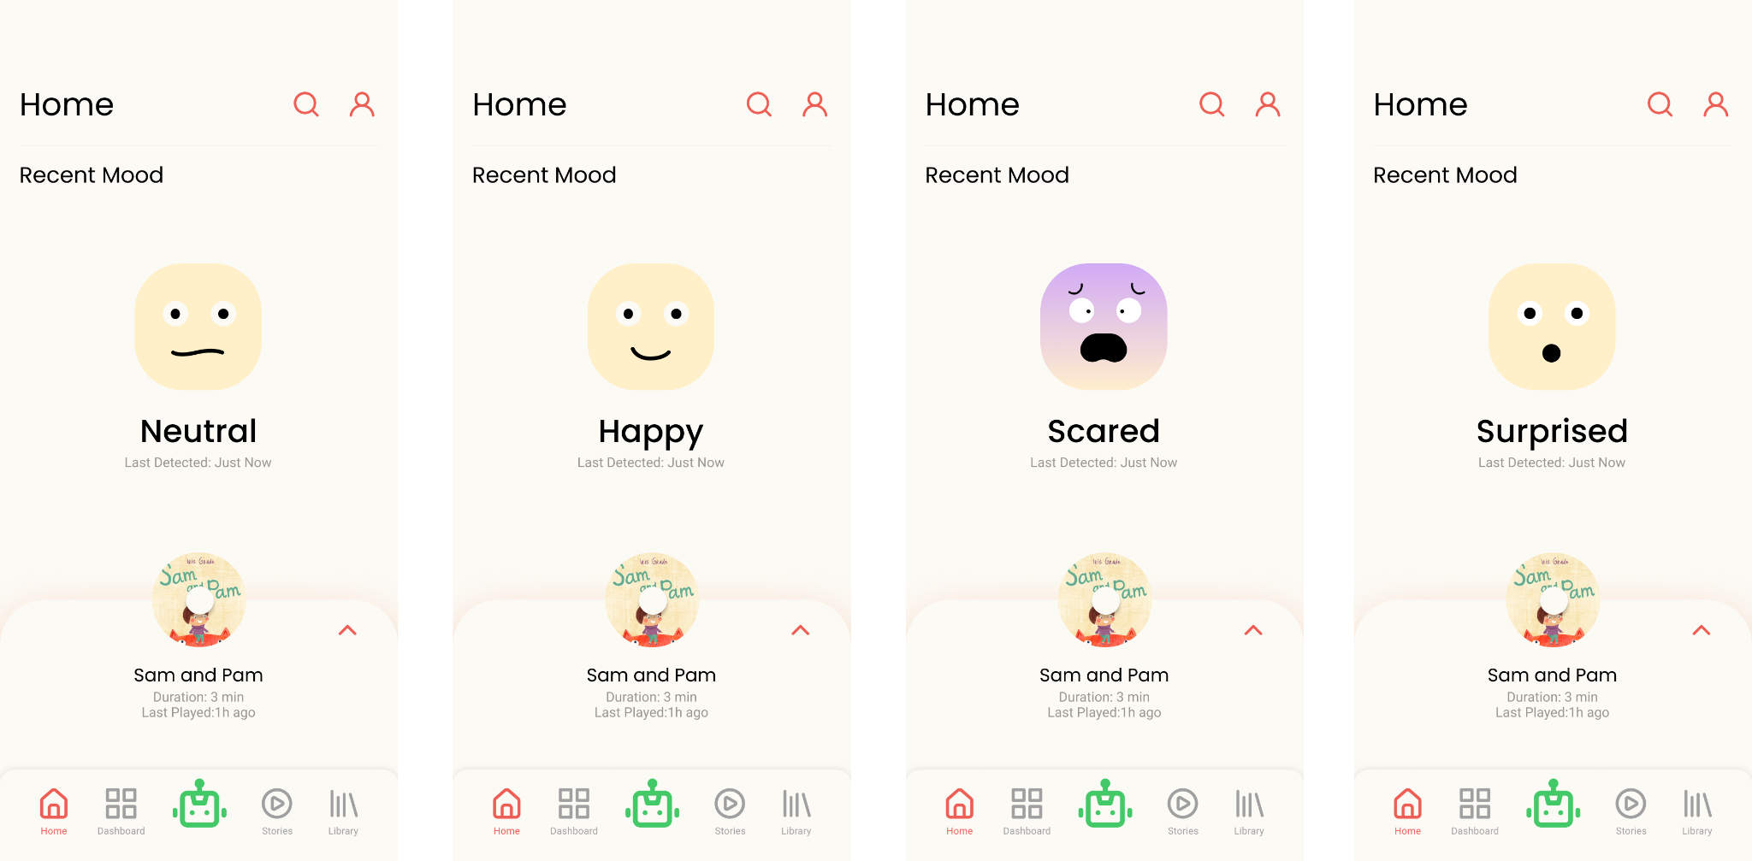

Slide 23

Displaying mode
Data presented in Recent mood screen tells the parent about how their child has been feeling lately, what his mood was and what story has been played on our robot.
Data is stored in database as history points, where each history point is a document containing child id, robot id, story id.
This allows us to keep track of how the child's mood has been changing overtime.
So, to show latest mood and latest played story we need to query latest history point which belongs to this child.

Slide 24
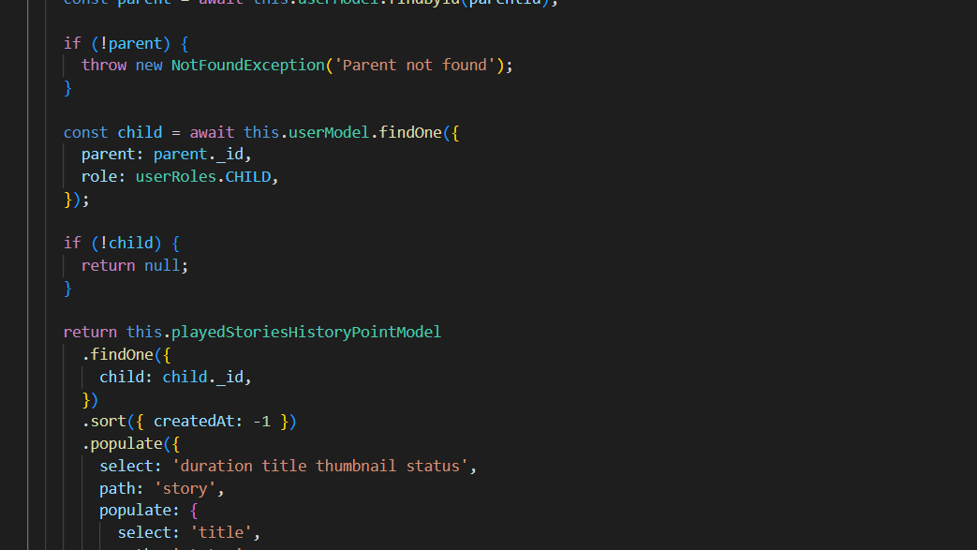

Slide 25
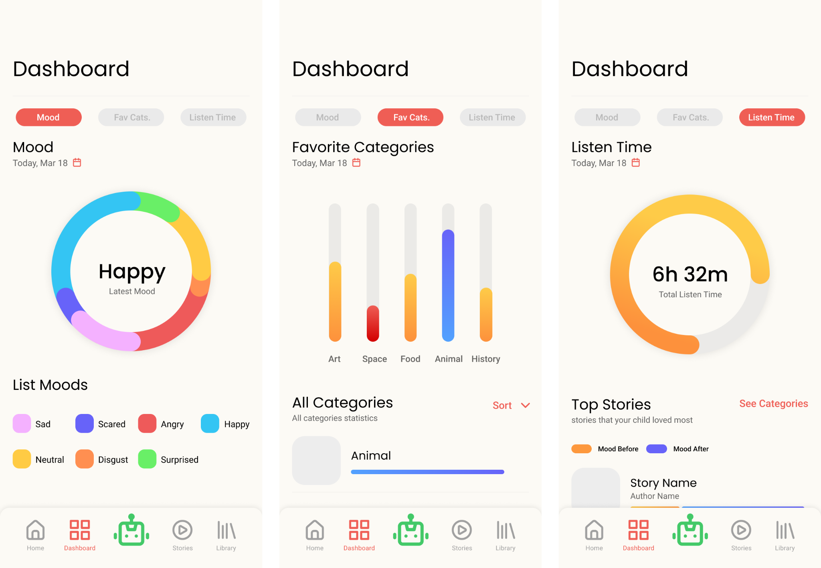

Slide 26
Dashboard: mode screen
Data presented in Dashboard -> Mood screen gives the parent an overview about how their child has been feeling over the day, and how the emotional status has been changing in a period of 24 hours.
Data is stored in database as history points, where each history point is a document containing child id, robot id, story id.
Data presented on Dashboard -> Mood screen is obtained using an aggregation pipeline, where first stage is just a query matching all history points in a period of 24 hours to the child id.
Second pipeline stage is about grouping documents from previous stage by status, and adding 1 to an accumulator field, so we know what emotional status was most recorded.

Slide 27
Cont. Dashboard: mode screen
Third pipeline stage is about joining documents from previous stage with emotional status collection, so we can get name of each status, without looking them up we only have a bunch of Object IDs.
Fourth stage is just unwinding status field, what that means is spreading elements of an array into separate documents, that happens in the first place because $lookup stage yields documents in an array, even if it is just 1 document.
Fifth stage in just about selecting which fields is returned to user, it is always better to send only data needed on client side, no need for extra data transferred over the wire + we need to restrict certain users to be able to access only allowed pieces of information, some data are classified.

Slide 28
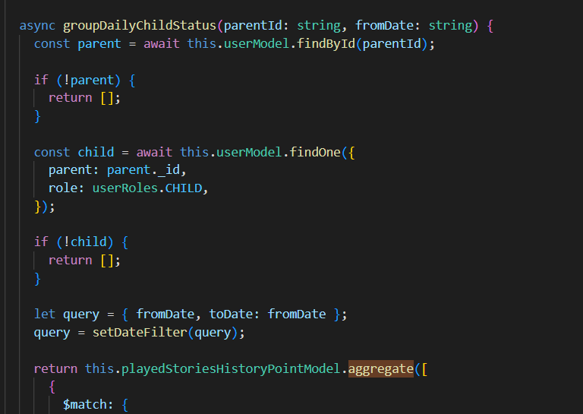
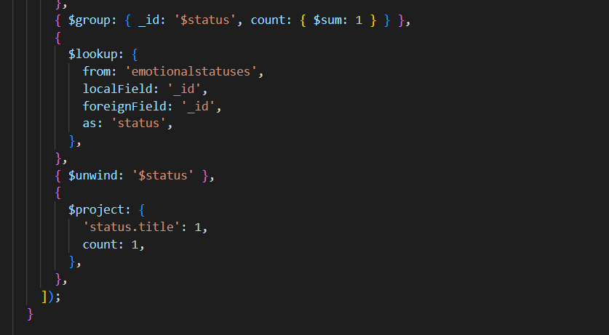

Slide 29

Dashboard: listen time
Data presented in Dashboard -> Listen Time screen tells the parent how much time did their child spend listening to stories on the robot in a period of 24 hours.
Data is stored in database as history points, where each history point is a document containing child id, robot id, story id.
Data presented on Dashboard -> Listen Time screen is obtained using an aggregation pipeline, where first stage is just a query matching all history points in a period of 24 hours to the child id.
Second pipeline stage is about grouping documents from previous stage by story, and adding 1 to an accumulator field, so we know how many times a story has been played.

Slide 30

Cont. Dashboard: listen time
Third pipeline stage is about joining documents from previous stage with stories collection, so we can get title and duration of each story, without looking them up we only have a bunch of Object IDs.
Fourth stage is just unwinding story field, what that means is spreading elements of an array into separate documents, that happens in the first place because $lookup stage yields documents in an array, even if it is just 1 document.
Fifth stage is where we calculate how much time each story has been played, by multiplying the value of accumulator field ( From 2nd stage ) by the story duration.
Sixth stage is where total listening time is calculated.

Slide 31
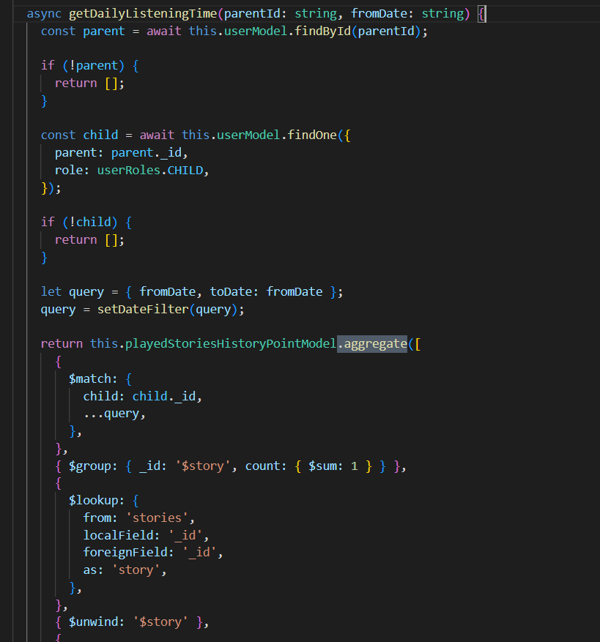
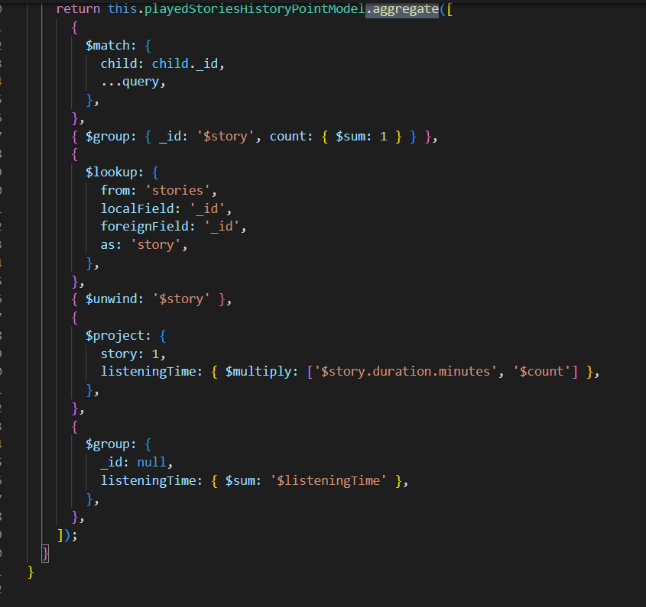

Slide 32
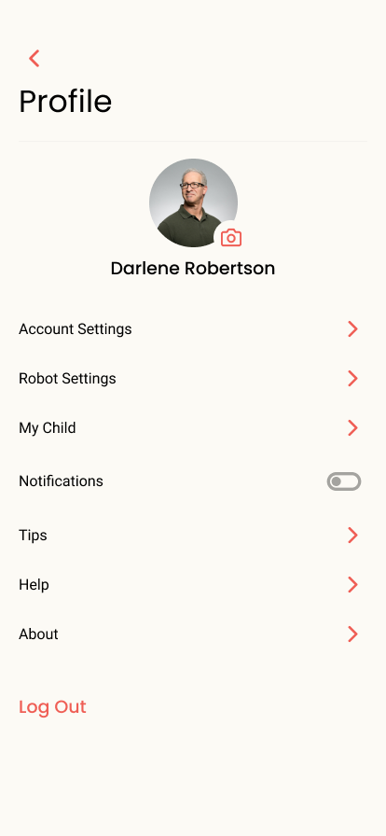
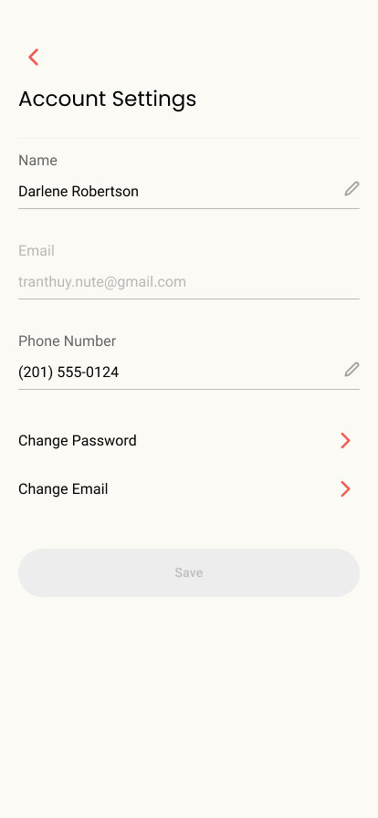
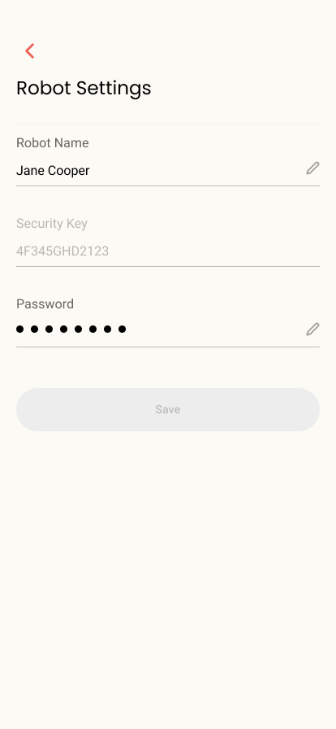
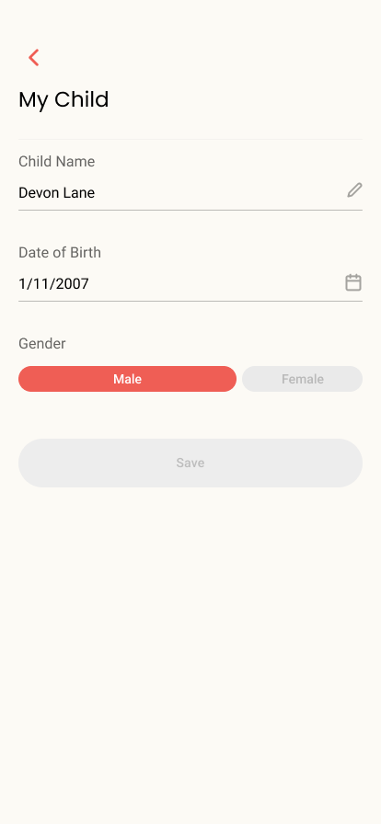

Slide 33
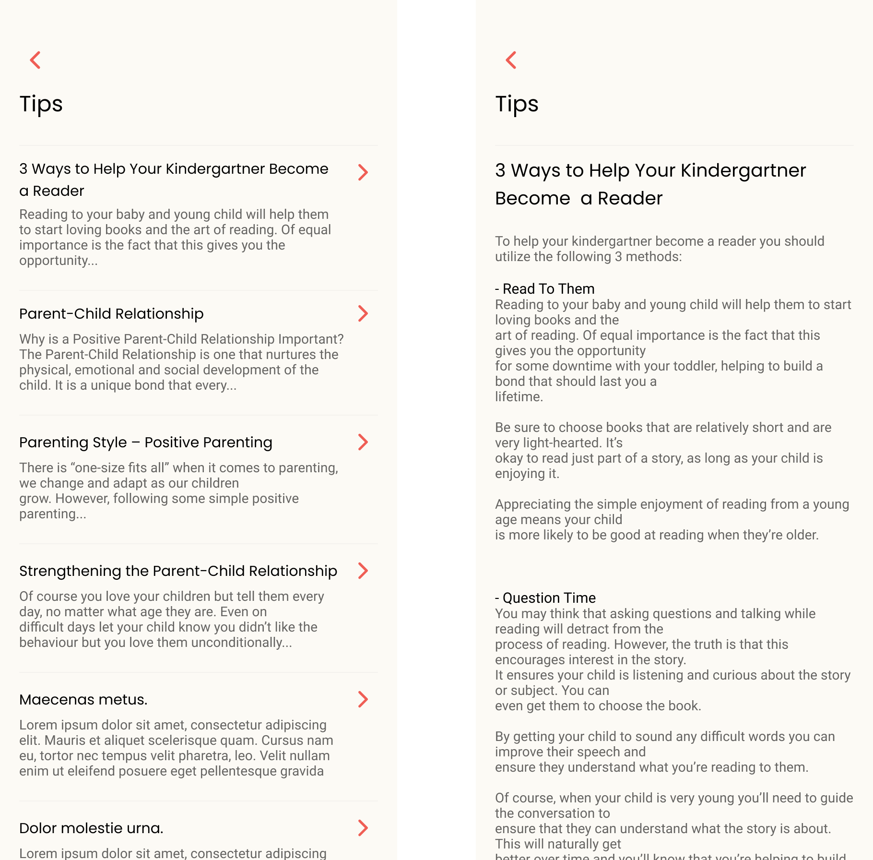

Slide 34
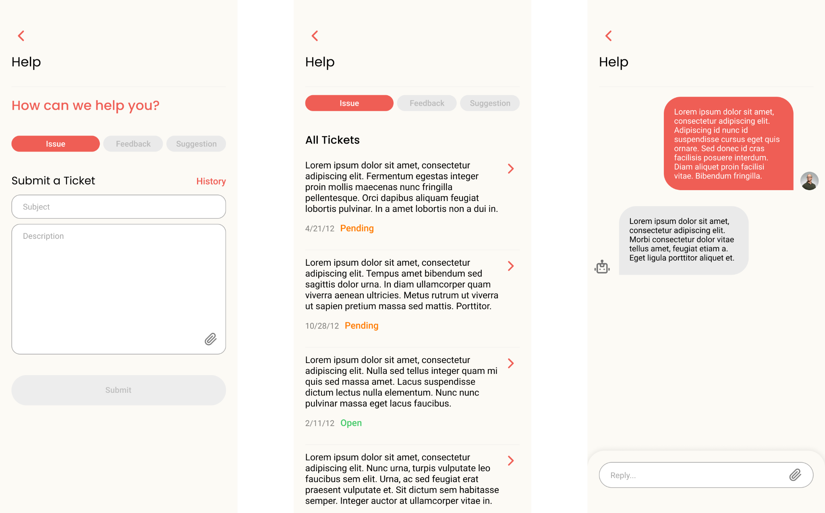

Slide 35
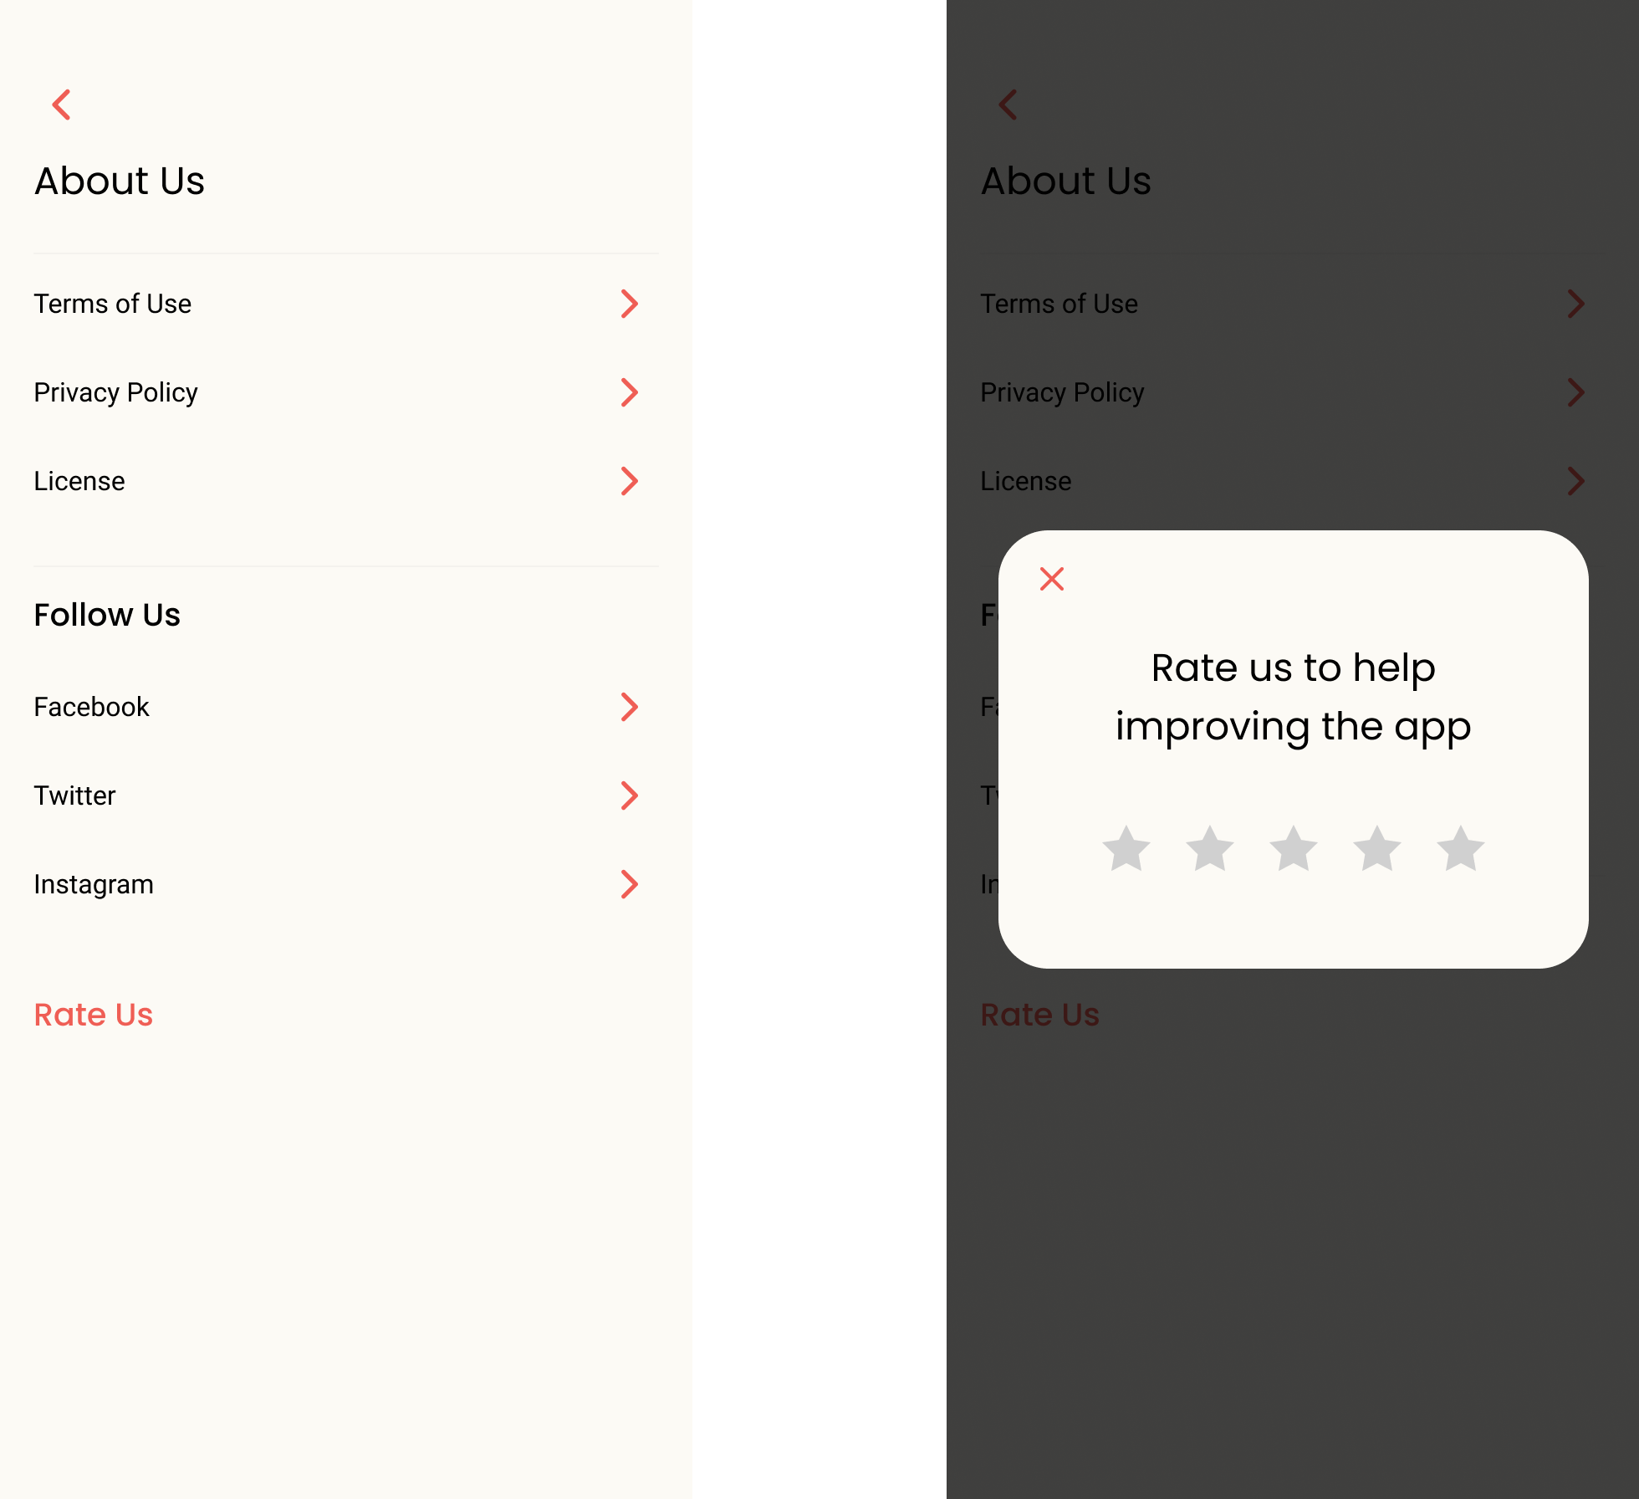

Slide 36
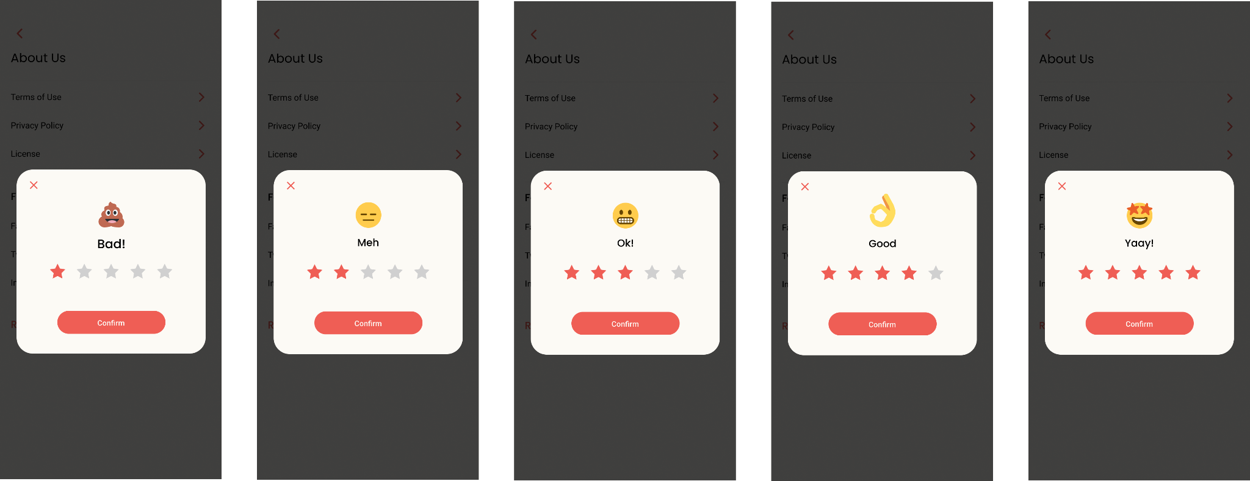

Slide 37
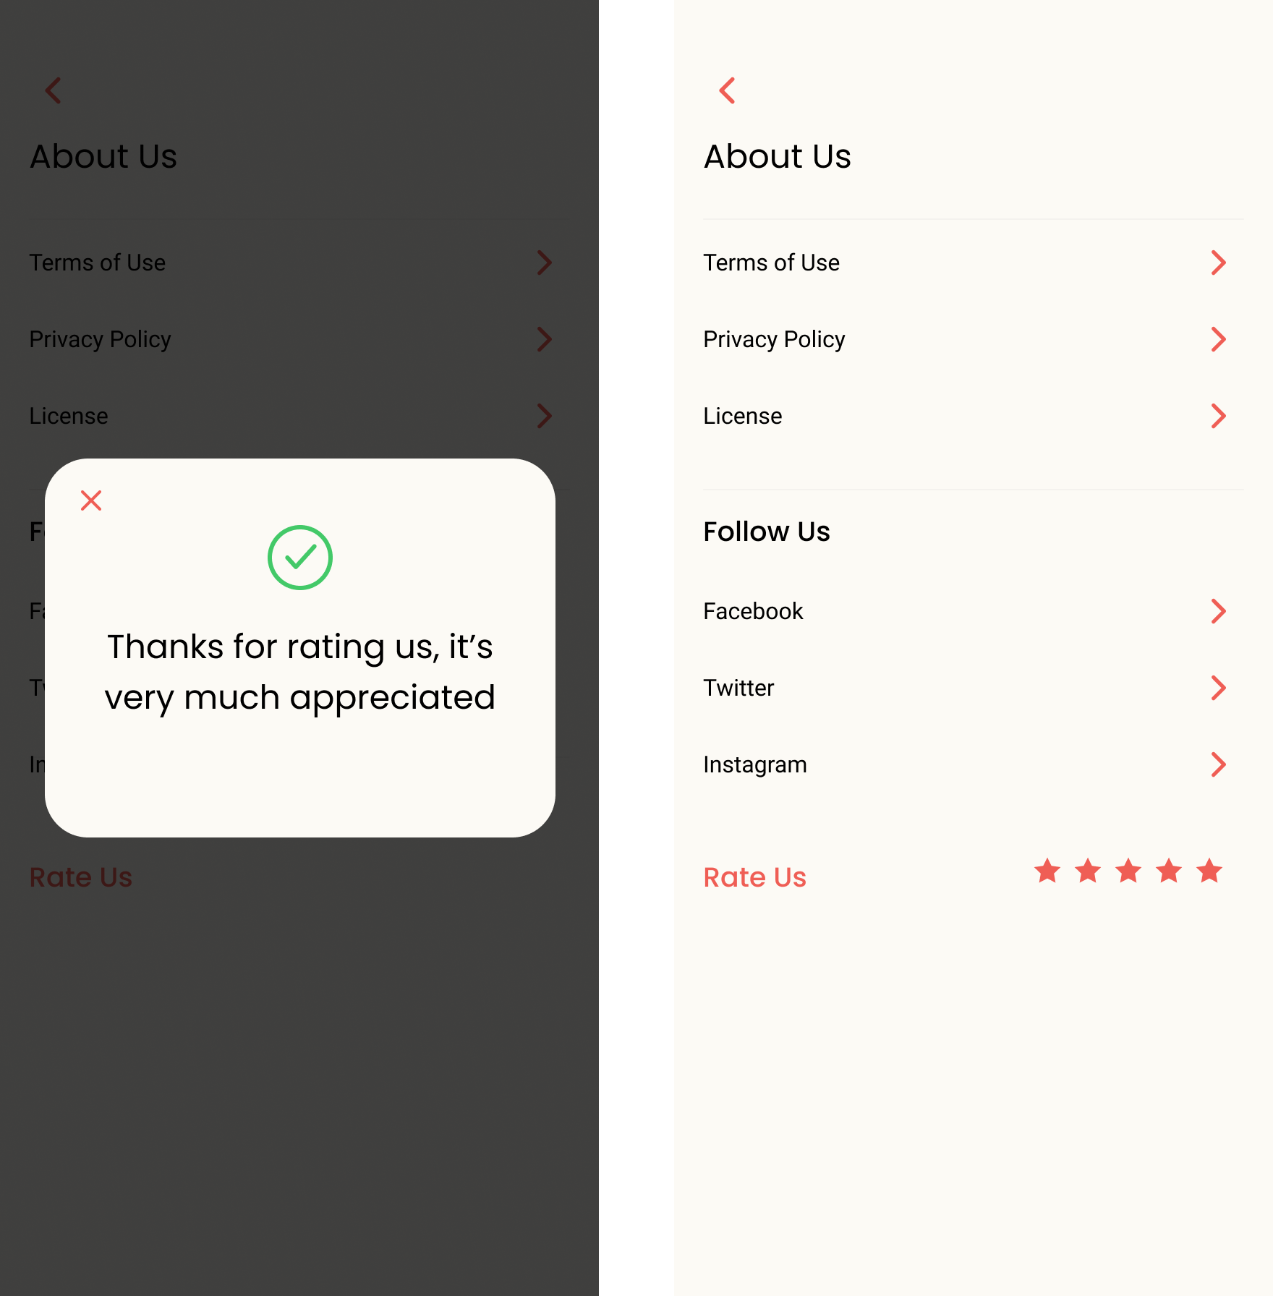

Slide 38

Connecting the robot to the Inernet
In the beginning, the first and most important thing is to connect the robot to the internet. There are many ways to do so but the most user friendly one is to use Captive Portal.

Slide 39
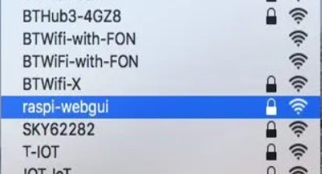
Captive portal
Captive portal is a webpage That opens automatically in the user’s default browser when the user tries to connect to the raspberry pi from a smartphone.
At startup, the raspberry pi will be acting as an access point. As soon as the user connects to the network created by the raspberry pi, a webpage opens in the user’s default browser.

Slide 40
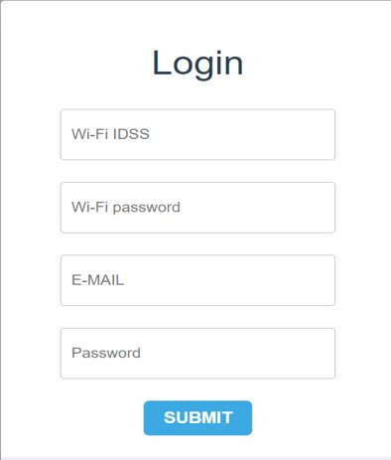
Captive portal
The user will typically need to provide some data before they can move on from the captive portal.
After the user provides the Wi-Fi SSID and the password, the raspberry pi will connect to this network. The SSID and password of the Wi-Fi will be saved so that the robot could connect to it automatically in the future if it is available. ​

Slide 41
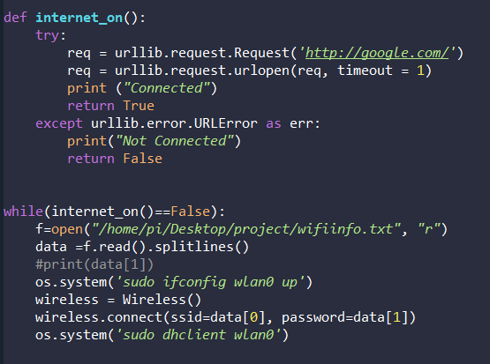
Internet on?
We try to make sure that we are online by connecting to google.com and if a response comes from the server, this means that the robot is online.

Slide 42
Ineraction with the server
The raspberry pi will connect to the server for the following tasks:
Authentication.
Getting the ID of each status.
Sending the actual status from model.
Receiving the link of the suitable story.

Slide 43
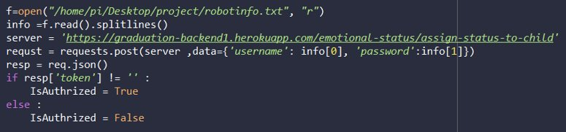
1. Authentication
The username and password entered by the user are sent to the server to be checked. If they are correct, the server replies with a token, which will be used in the next requests.

Slide 44
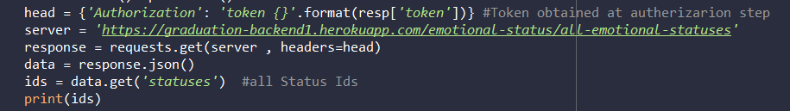
2. Getting status ids
For a good communication with the server, each status must have a unique ID assigned at the server side. A GET request containing the token obtained before will be sent to the server to get these IDS.​

Slide 45
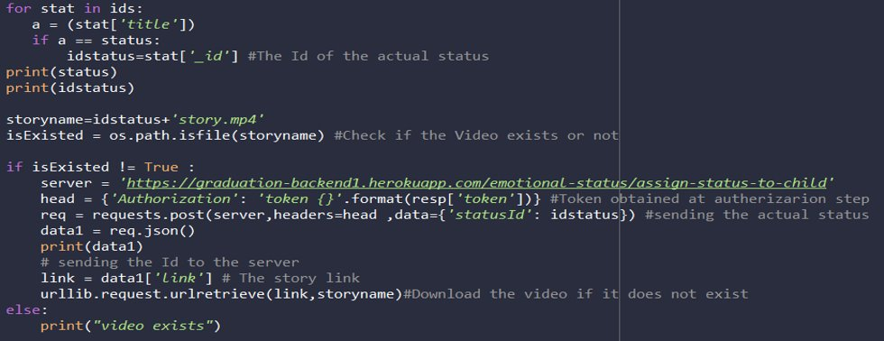
3. Sending the output status to the server
The parent can always monitor the status of his child so it`s so important to send the status obtained by the model periodically through a POST request to the server to be redirected to the application.

Slide 46
4. Receiving the link of the suitable story.
On getting the actual status, the server will reply with the story link that suits the child status. If already downloaded, it will be played directly. Else it will be downloaded at first.

Slide 47
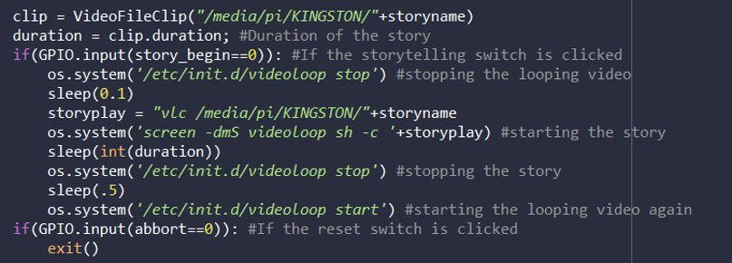
Default video looping
To make the robot attractive all the time to the child, a looping video is played in the times, when there are no stories to be played. The looping video is paused for a while (duration of the story) and after it ends, the looping video will be replayed again​

Slide 48
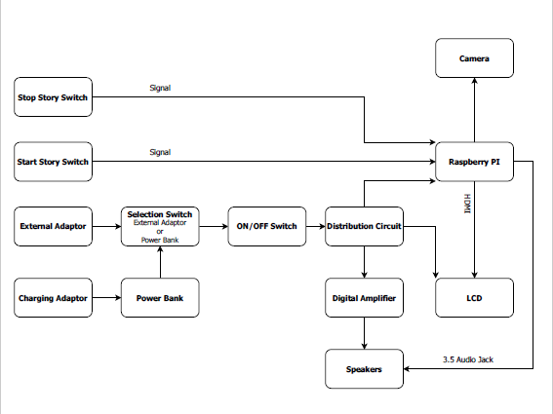

Slide 49
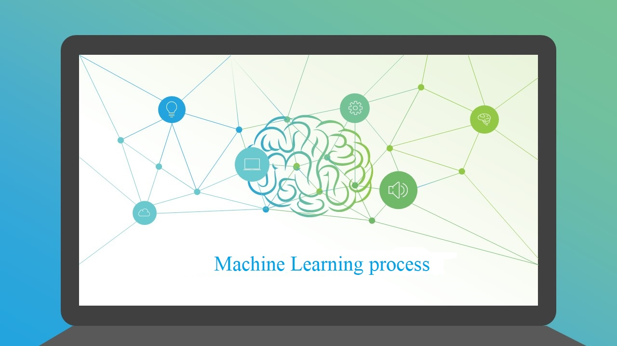

Slide 50
Datasets
1- CAFE
Child Affective Facial Expression: 1192 photos from 154 sessions.
2- ChildEFES
Child Emotion Facial Expression Set: 158 photos and 167 videos.
Both datasets have seven different facial expressions:
[Angry, Disgust, Fear, Happy, Neutral, Sad, Surprise]

Slide 51
Why not use web scraping?

Slide 52
Data preparation
1- structuring and organizing data
2- Extracting Faces
3- Converting into grayscale
4- resizing images
5- Saving data into .pickle file.

Slide 53
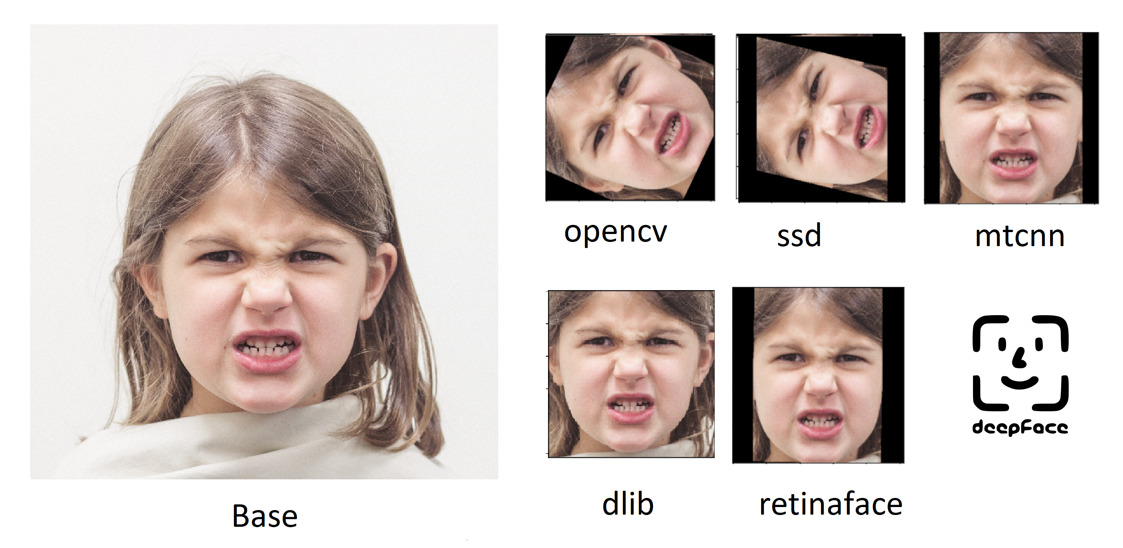
Extracting Faces

Slide 54
Choosing model
Transfer Learning:
1- Xception
2- MobileNetV2
3- EfficientNetB0

Slide 55
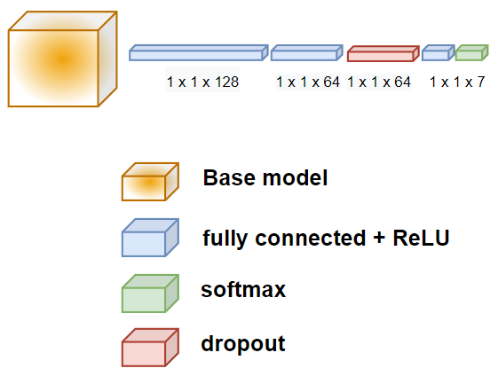
Getting everything ready
Customize the model
1- Exclude the top layer
2- Load weights trained on the “imagenet” dataset.
3- Customize the model to our problem.
4- Convert images into 3-channel grayscale images.
5- Rescale pixels range.
6- Data augmentation.
7- Callbacks.

Slide 56
Hyperparameters
Optimizer: Adam
Learning rate: 0.0001
Loss: categorical cross-entropy
Metrics: accuracy and f1-score
Dropout rate: 0.2
Epochs: 50

Slide 57
Training and validation
Model | Accuracy | Test Accuracy | f1-score | Training time (Per epoch)
EfficientNetB0 | 0.955 | 0.84.9 | 0.84 | 51 seconds
MobileNetV2 | 0.942 | 0.834 | 0.83 | 26 seconds
Xception | 0.961 | 0.863 | 0.88 | 30 seconds

Slide 58

Hyperparameters optimization
A tutorial on automatic hyperparameter tuning of deep spectral modeling for regression and classification tasks.

Slide 59
Optimized Hyperparameters
Model | Dropout rate | Optimizer | Learning rate | Optimizer momentum
EfficientNetB0 | 0.134 | Adam | 0.0004 | ----
MobileNetV2 | 0.054 | SGD | 0.0103 | 0.0044
Xception | 0.126 | SGD | 0.0947 | 0.3985

Slide 60
Training and validation (with optimized hyperparameters)
Model | Test Accuracy |  |  | f1-score
 | Before optimization | After optimization | change | Before optimization | After optimization | change
EfficientNetB0 | 0.849 | 0.871 | +2.2% | 0.841 | 0.869 | +2.8%
MobileNetV2 | 0.834 | 0.856 | +2.1% | 0.833 | 0.851 | +1.8%
Xception | 0.863 | 0.889 | +2.6% | 0.862 | 0.885 | +2.3%

Slide 61

Thank you from TEMA team

